Slide 1


hSO: Hierarchical Semantics of Objects
Devi Parikh and Tsuhan Chen

Slide 2

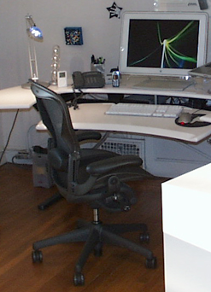

What do you see?
Offices
Monitors, keyboards, phones and chairs
Computers, phones and chairs
Desk-stuff and chairs

Slide 3
hSO: Hierarchical Semantics of Object
OFFICE
desk-area
CHAIR
UNSUPERVISED ?
computer
PHONE
KEYBOARD
MONITOR
Collection of images of a scene
Corresponding hSO

Slide 4
Approach
Intuition: Semantic relationships → consistent relative locations
Images of a particular scene
Feature extraction
Feature extraction
Feature selection
Feature selection
Interaction between pairs of features (parts)
Interaction between pairs of features (parts)
Recursive clustering
Recursive clustering
Learnt hSO

Slide 5
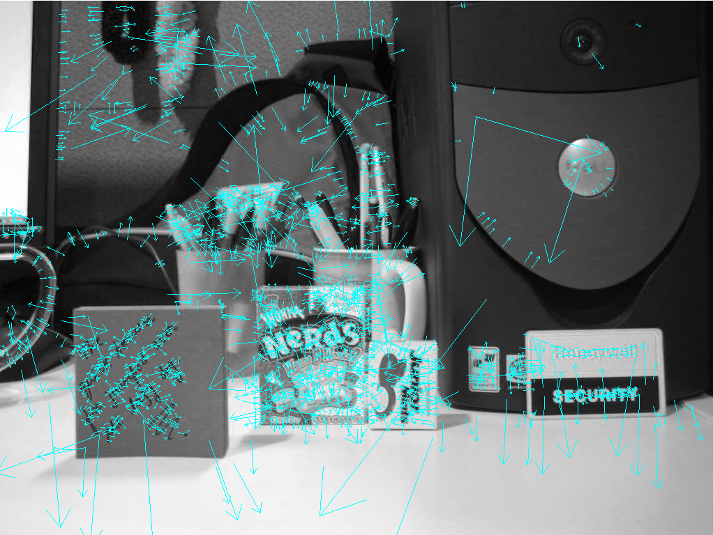
Feature extraction
Images of a particular scene category
Feature extraction
Feature selection
SIFT
Interaction between pairs of features
Recursive clustering
Learnt hSO

Slide 6
Feature selection
Images of a particular scene category
Feature extraction
Feature selection
Interaction between pairs of features
Geometrically consistent correspondences
Keep features that are geometrically consistent
Remove background clutter
Among all pairs of images, keep features found in enough images
Keep popular objects
Recursive clustering
[Leordeanu et al., ICCV 2005]
Learnt hSO

Slide 7
Geometric consistency
Images of a particular scene category
Feature extraction
Feature selection
Interaction between pairs of features
Recursive clustering
Learnt hSO
image₁
image₂
Φ_{a}(a) = A
A
a
d(B,β)
b_{a}
Φ_{a}(b_{a}) = β_{Α}
β_{Α}
b
B
β

Slide 8



So far…
Images of a particular scene category
Feature extraction
Feature selection
Did not find geometrically consistent correspondences
Interaction between pairs of features
Recursive clustering
Learnt hSO
Did not find correspondences in enough images

Slide 9

Pairs of features
Images of a particular scene category
Feature extraction
Feature selection
Metric to quantify interaction between two features:
Geometric consistency between features across images
Interaction between pairs of features
Recursive clustering
Learnt hSO

Slide 10

Pairs of features
Images of a particular scene category
Feature extraction
Feature selection
Metric to quantify interaction between two features:
Geometric consistency between features across images
Interaction between pairs of features
Recursive clustering
Learnt hSO
object1
object2
object3
object4
object1
object2
object3
object4

Slide 11
Hierarchical clustering
Images of a particular scene category
Feature extraction
Feature selection
Interaction between pairs of features
Normalized Cuts [Shi et al., PAMI 2000]
Form two clusters
Analyze statistics of both clusters and identify which (possibly both) clusters should be further clustered
Recursive clustering
Learnt hSO

Slide 12
Pairs of objects
Images of a particular scene category
Feature extraction
Feature selection
Metric to quantify interaction between two objects:
Correlation in locations
Interaction between pairs of features
Recursive clustering
Learnt hSO
Monitor
Keyboard
Phone
Chair
OFFICE
Monitor
Keyboard
CHAIR
Phone
PHONE
Chair
KEYBOARD
MONITOR

Slide 13
Photo Grouping

Slide 14
Photo Grouping
SCENE

Slide 15
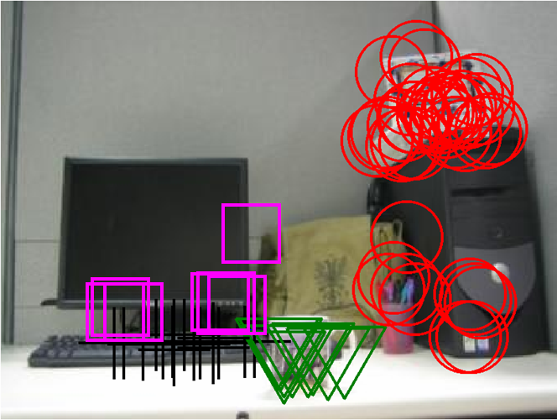
Semantic understanding of scene
SCENE

Slide 16

Context: Why hierarhical?

Slide 17
hSO for context
Learn parameters during training
Testing…
SCENE
L₂
L₁
L₀
run individual detectors

Slide 18
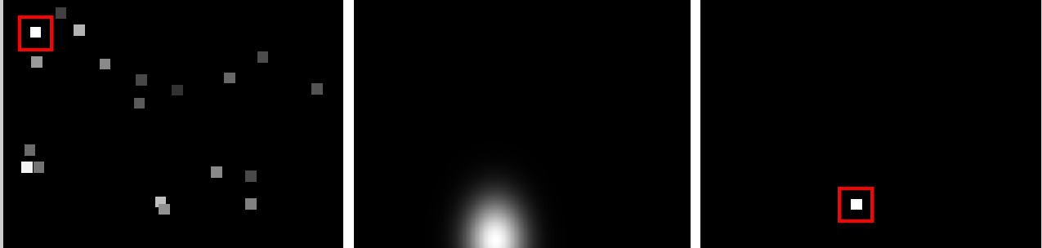
Results
detector
detector + context
test image
Keyboard detections
Context by monitor
Refined keyboard detections

Slide 19
Results
test image
symbols key
detector
detector + context

Slide 20
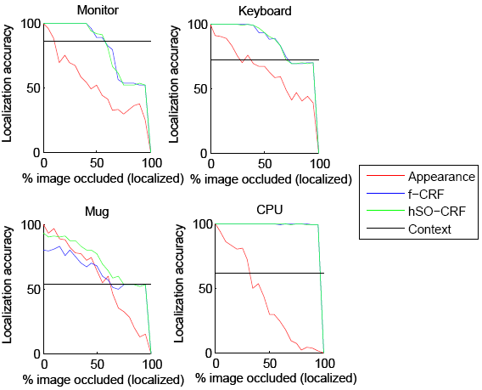
Results

